Slide 1

Capstone Project – Interim Report
OLIST- ECOMMERCE
Submitted by:
Shivakanth Reddy
MD. Sohail Abrar
Zehna Erum Khan
Prudhvi Raj
Mentor:VIBHA SANTHANAM

Slide 2
Problem Statement
Analysing the dataset that contains information like purchases, product and its attributes, reviews given by the customer to predict the customer review rating.

Slide 3

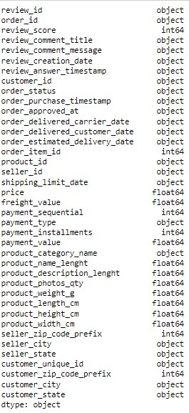
Data Set Description:
This is a Brazilian ecommerce public dataset of orders made at Olist Store. The dataset has information of 100k orders from 2016 to 2018 made at multiple marketplaces in Brazil. The dataset has 117329 rows with 39 features. Refer to the below-detailed structure of the dataset.

Slide 4
Project Methodology
1
2
3
Data cleansing and Data preparation
4
Data Analysis
Identify the data source available
Understanding the data
5
Feature Engineering
6
Model Building
7
Model Validation
8
Recommendations

Slide 5
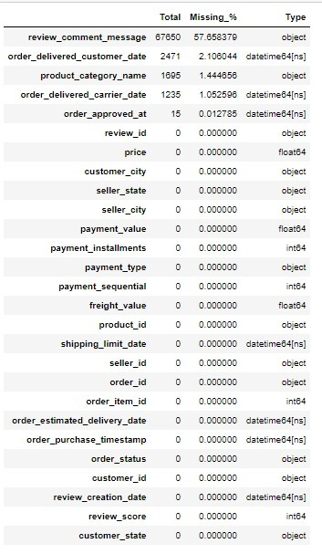
Pre Processing Data Analysis
In the dataset order approved date, order delivery date,product_category_name,order_delivered_customer_date have null values less than 10%. So, we can drop the rows.
The review_title have null values of more than 90%. So, we can drop variable.

Slide 6
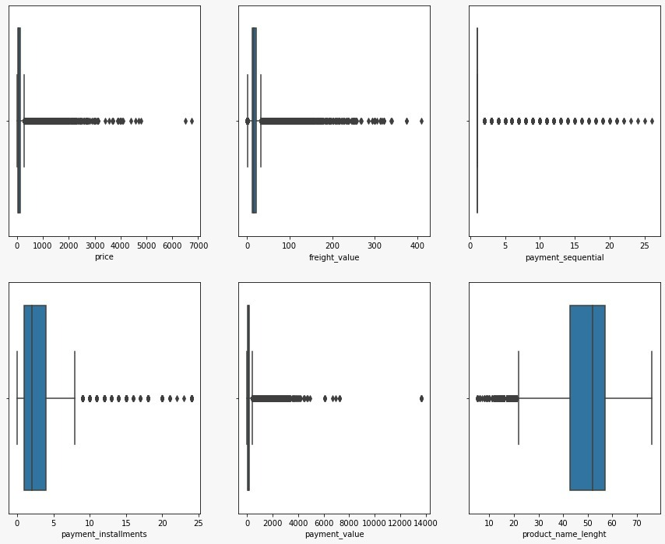
Outliers
The outliers are present in the retail price and discounted price column. As the prices are significantly unique to each product, which ranges from very low value to very high value, we are not excluding the outliers instead we would implement a transformation technique considering the outliers thereby reducing the skewness.

Slide 7
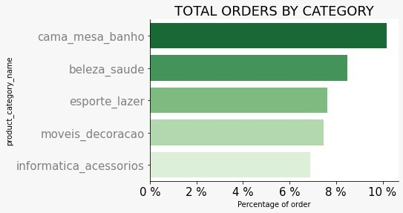
Redundant Columns
Exploratory Data Analysis
These are the top five categories of
products based on the orders.
The below are the redundant features that have all the unique values and are dropped from the dataset.
⦁ Customer_id
⦁ Order_item_id
⦁ Review_id
order_item_id
product_id

Slide 8
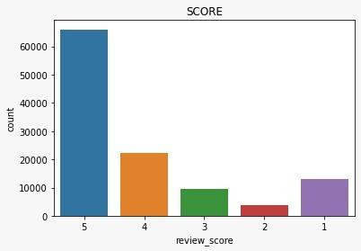
Exploratory Data Analysis
Univariant
Analysis on target
column;
This graph shows that review
score have maximum 5 star rating.

Slide 9
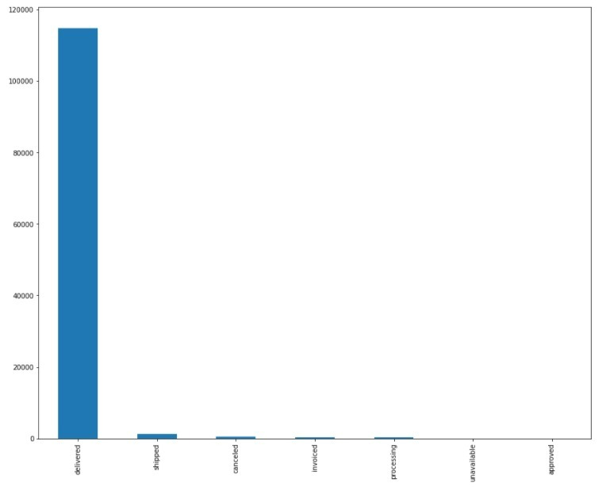
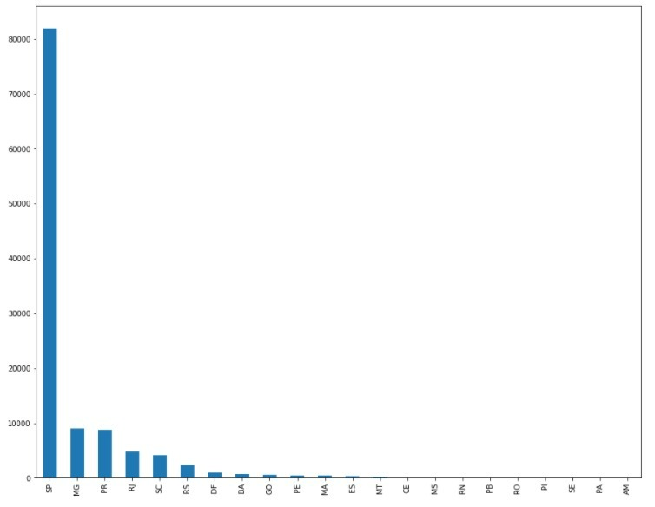
ANALYSIS OF ORDER STATUS & SELLER STATE

Slide 10
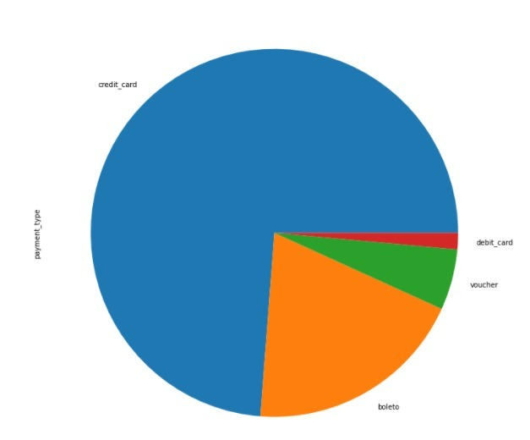
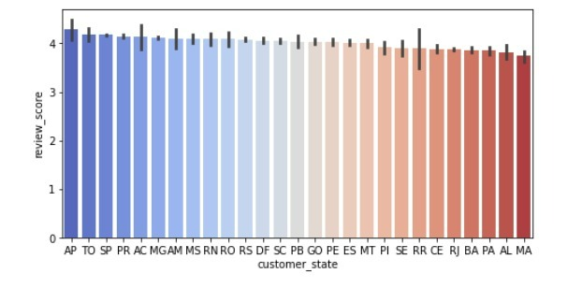
ANALYSIS OF PAYMENT TYPE
BIVARIANT ANALYSING REVIEW SCORE AND CUSTOMER STATE

Slide 11
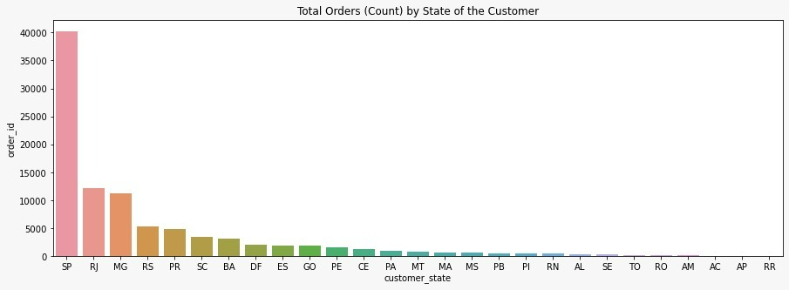
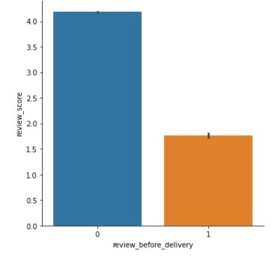
ANALYSIS OF TOTAL ORDERS BY STATE OF CUSTOMERS
EFFECT OF LATE DELIVERY ON REVIEW SCORE

Slide 12
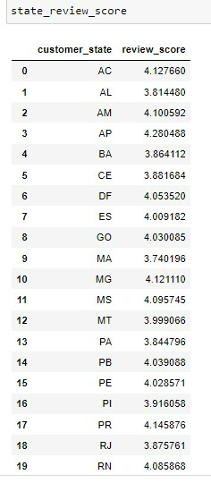
Exploratory Data Analysis

Slide 13
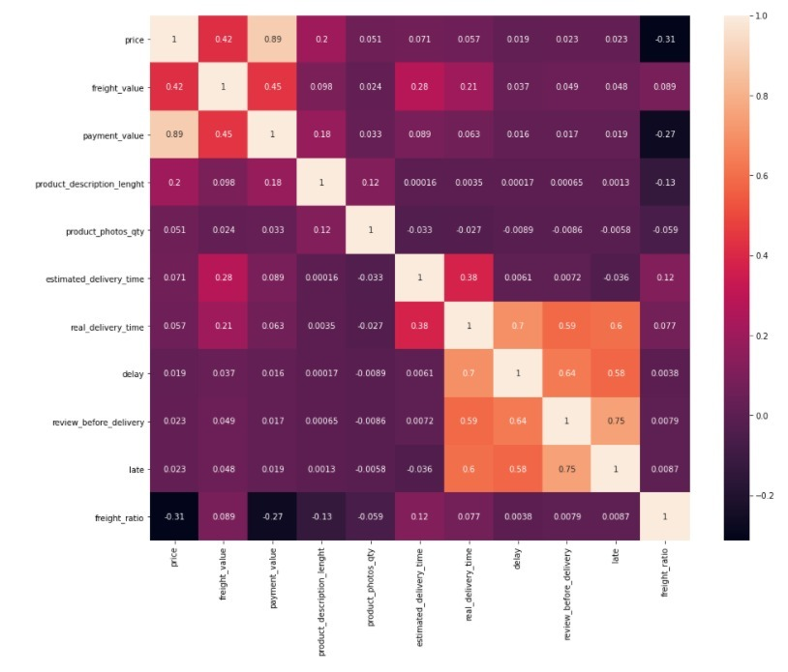
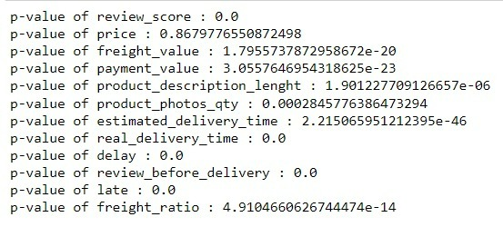
FEATURES IMPORTANCE
MULTICOLLINEARITY

Slide 14
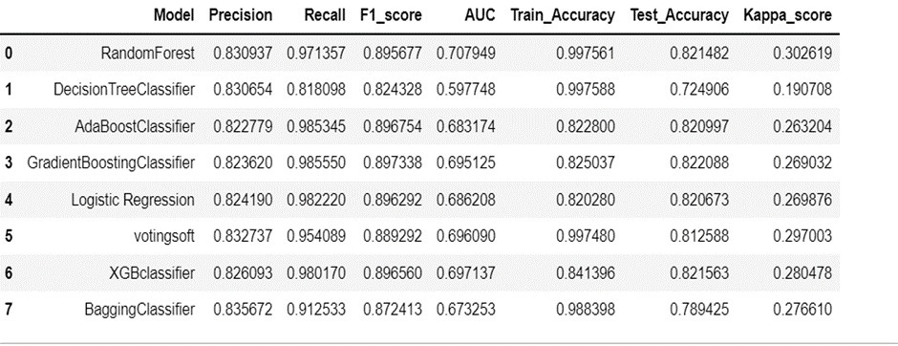
SCORE CARD
V

Slide 15
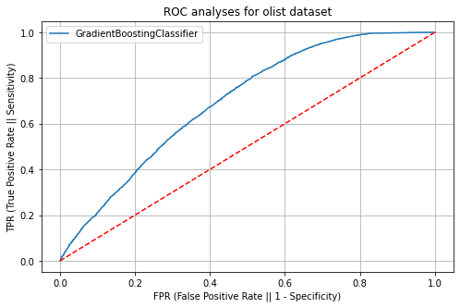
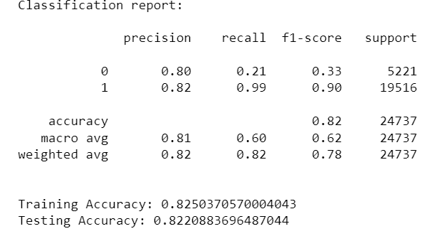
Model Building
Base Model : gradient boost
ROC CURVE
CLASSIFICATION REPORT

Slide 16
Business justification
Customer loss happens if type1 error exists so we try to reduce type 1 error
Company will get loss if type2 error exists
Customer loss is more costly than company loss so we try to make false positives as minimum as possible ,so we choose precision as a performance metric.
From the above model comparison table, the gradient boost model has good precision compared to other models. So, we are considering the gradient boost as a base model.

Slide 17
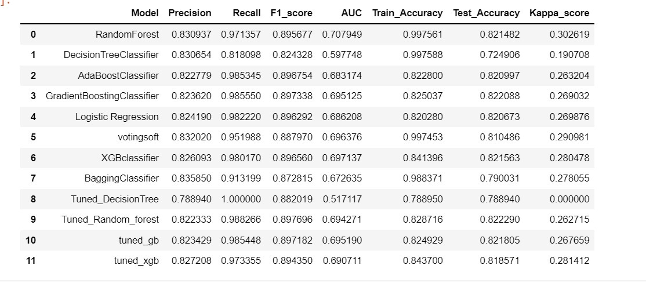
TUNED SCORE CARD
After hyper tuning also score not improving and also it got overfitted so we will take base model as best model
BEST FIT MODEL : GRADIENT BOOSTING CLASSIFIER

Slide 18
Hyper tuning parameters of the Random Forest model, the model has not given better results compared to the base model. Since the main requirement is to maximize the precision so consider the gradient boost base model as final model. The Gradient Boost model provides better results (precision=0.82) with an accuracy of 0.82 as per our business scenario. The goal of this project was to analyse Olist’s business using data analytic to predict the customer review rating and to find the high performing sectors to value and those that need to be improved.
CONCLUSION

Slide 19
thankyou

